Slide 1
Data Pipelines
Series of data processing steps
ETL: Extract, Transform, Load
1. APIs and Requests
2. WebScraping
a) Selenium
b) Requests
Extracted data can have different formats (CSV, JSON, XLSX, XML)

Slide 2
Data Formats
There are multiple data formats
We will focus on the most common ones:
CSV and TSV
JSON
XLSX
XML

Slide 3
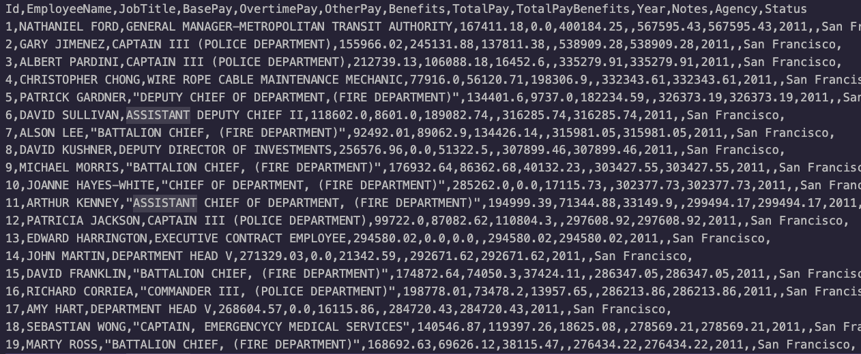
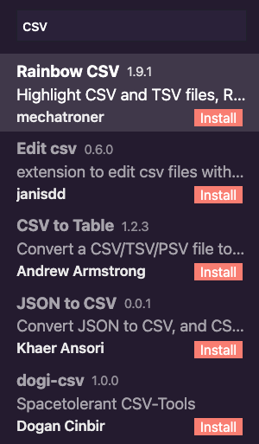
CSV
Comma Separated Value
One of the most common formats for spreadsheets
Essentially a text file where each line is a row, and each column is separated by a comma
You can read CSV files in VSCode looking in extensions
Commas are just delimiters, we can also find other formats such as tsv (tab)

Slide 4
CSV in Python
Import csv module
Usually handled with context managers:
with open(‘file,csv’, newline=‘’) as f:
reader = csv.reader(f) # reader becomes an iterable
We can do something similar to write:
with open(‘file,csv’, newline=‘’) as f:
writer = csv.writer(f)
writer.writerows(iterable) # Each item will be represented in a new line

Slide 5
JSON
JavaScript Object Notation
Human-readable text to store data
Equivalent of a dictionary in Python
It is commonly used for transmitting data in web applications
We can use json.load() and json.dump() to work with json files
We can use json.loads() and json.dumps() to work with json strings

Slide 6
XLSX
Excel files
Data is stored in tables, each table contains cells
We can use openpyxl to read xlsx
We can use xlsxwriter to write xlsx

Slide 7


Data Formats in Python
Python can read all these data formats using the corresponding module
However, a very common way to read them is using the very well known library: pandas

Slide 8
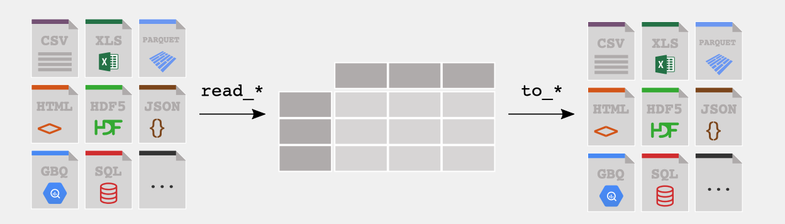
Pandas
Panel Data
Pandas allows us to work with data stored in spreadsheets or databases in a simple manner
Pandas create tables named DataFrames
You can read many file formats and export DataFrames to different formats

Slide 9
Using Pandas
Import pandas
You can import a file using the method read_{format}:
read_csv for csv
read_json for json
read_excel for xlsx
You can export a file using the method to_{format}:
to_csv for csv
to_json for json
to_excel for xlsx

